Slide 1
Trouble shooting
Version v2.3.3
2022.07.04
Hwan-ho Cho, Dept of Medical Artificial Intelligence, Konyang Univ.

Slide 2
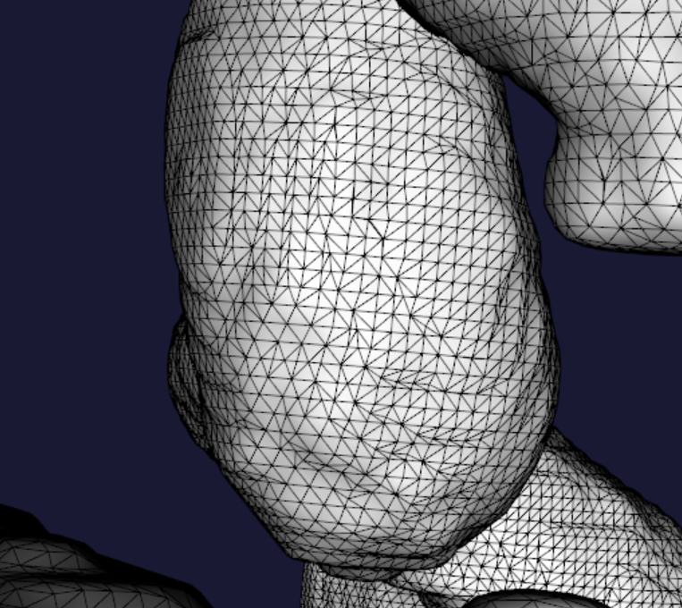
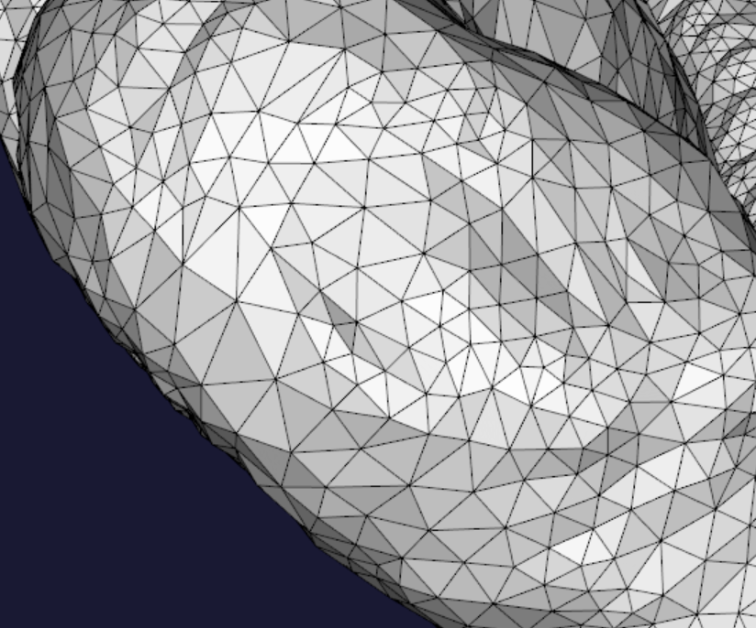
원인: Surface remeshing
Hwan-ho Cho, Dept of Medical Artificial Intelligence, Konyang Univ.

Slide 3
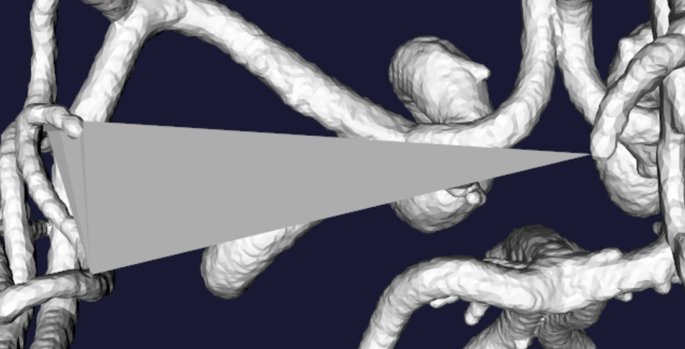
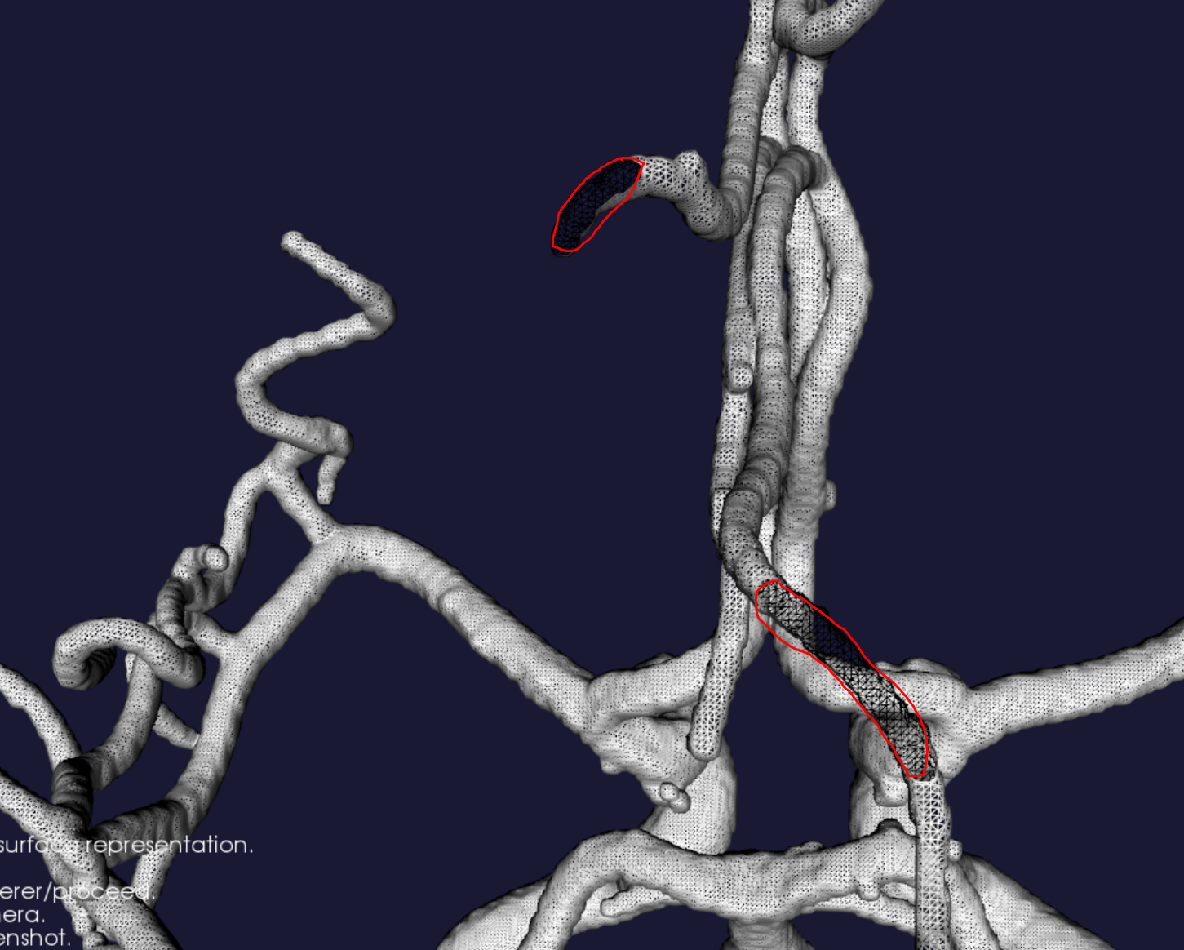
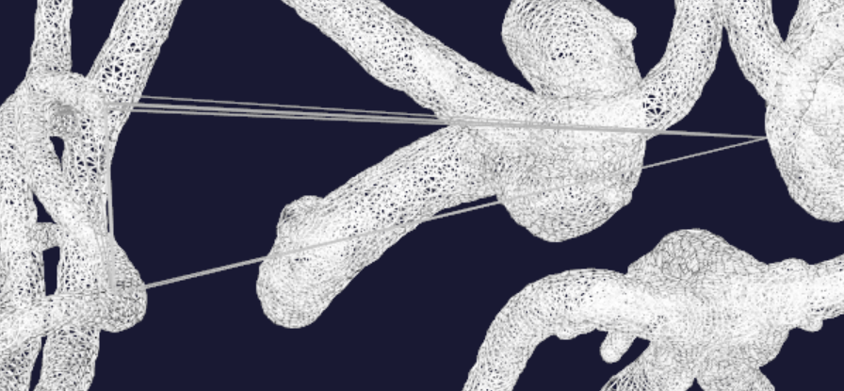
급격한 변화가 있는 부분(Ex. 구멍이 난 부분)에서 false edge가 잡히는 문제
→ Access violation 유발, 프로그램 down (예외처리 불가능)
Hwan-ho Cho, Dept of Medical Artificial Intelligence, Konyang Univ.

Slide 4
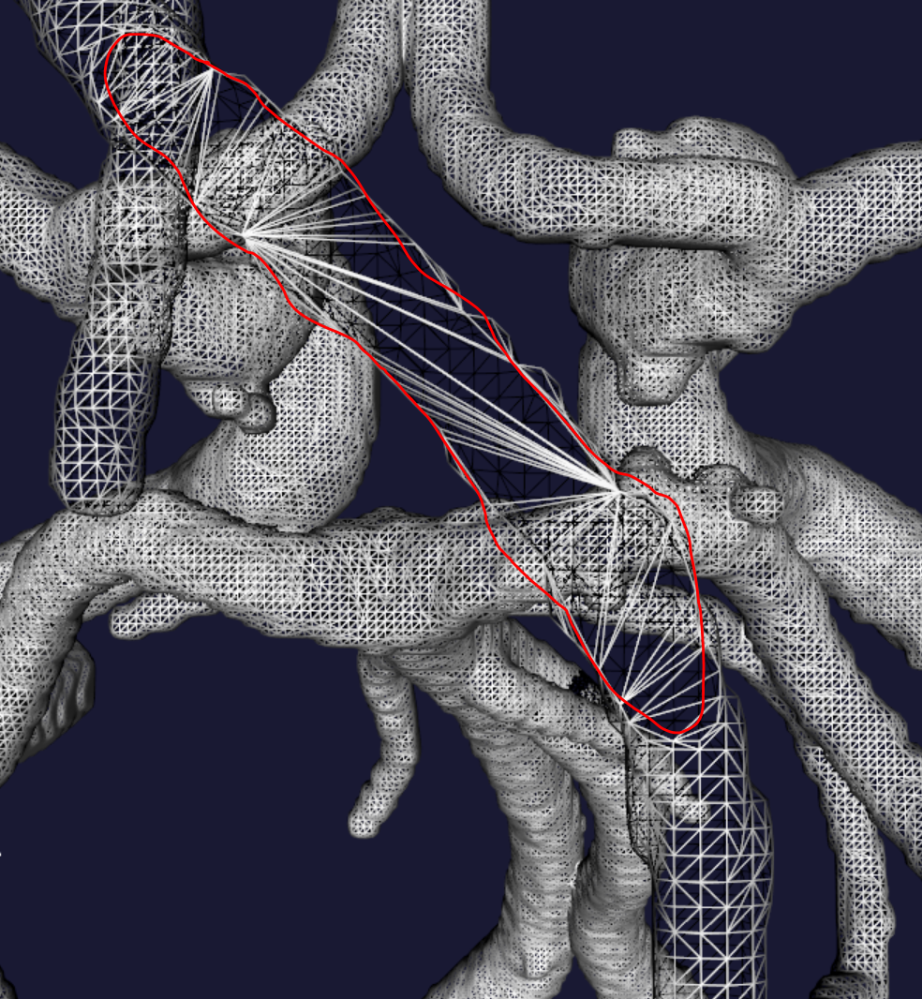
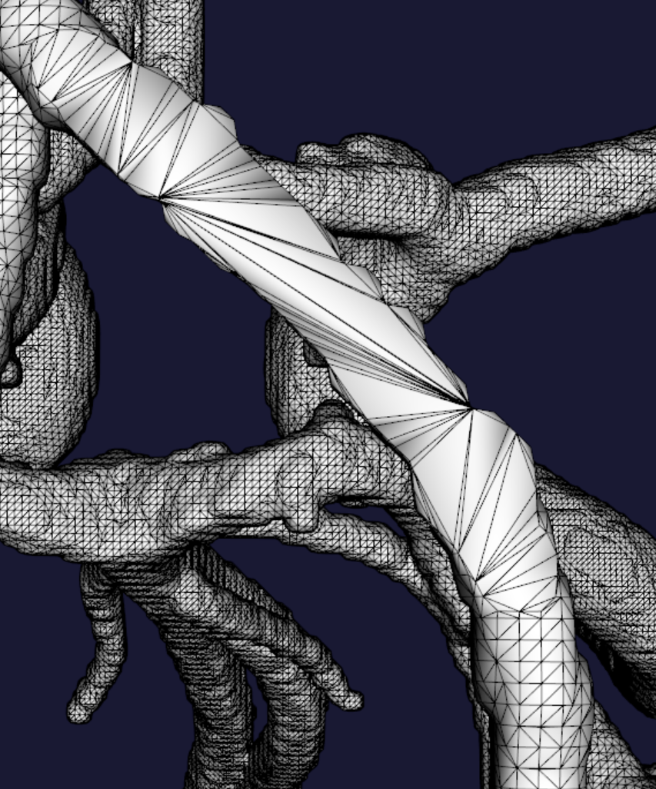
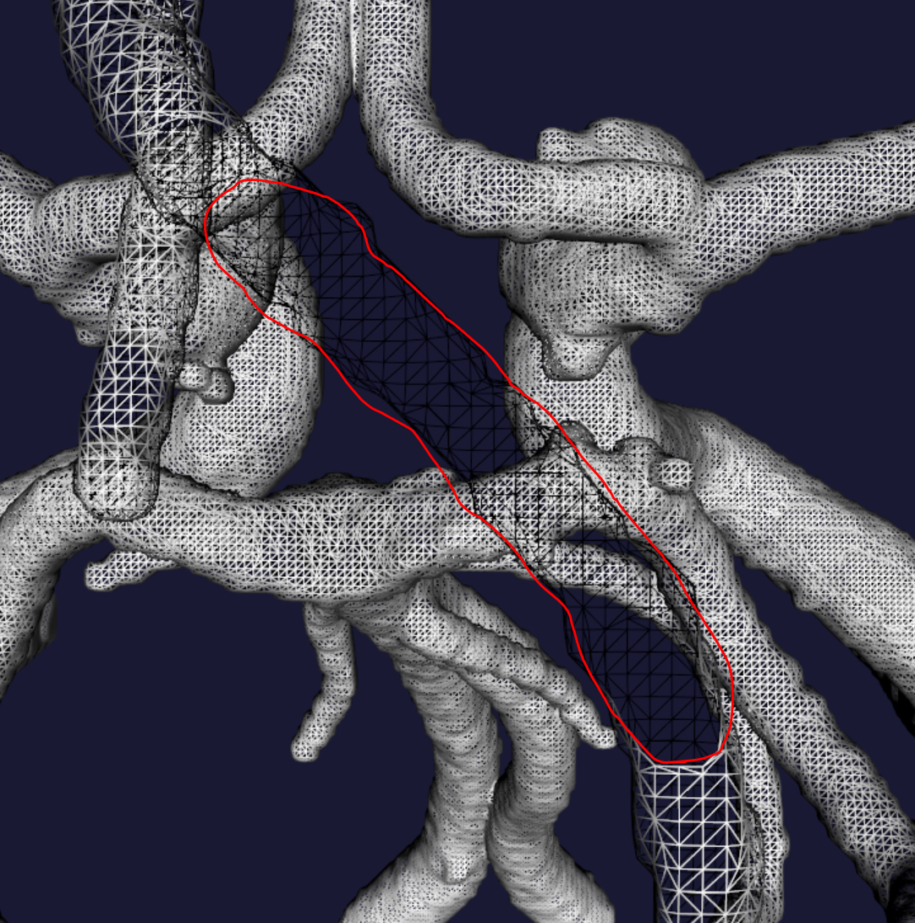
구멍 case → capping으로 매워줌
Hwan-ho Cho, Dept of Medical Artificial Intelligence, Konyang Univ.

Slide 5
이외 Updates
Surface level: 0.1 → Minimum level over 0
Vessel volume smoothing: 1mm → Resolution unit (ex. 0.2841 mm)
효과: 정확성 증가, stability 감소 (추후 되돌릴 수 있음)
Remeshing iteration: 1 → 2
효과: Computation cost 증가, more stable mesh quality)
Memory garbage collection
필요 없는 memory 비워 줌
Hwan-ho Cho, Dept of Medical Artificial Intelligence, Konyang Univ.

Slide 6
Visualizer
2022.07.04
Hwan-ho Cho, Dept of Medical Artificial Intelligence, Konyang Univ.

Slide 7
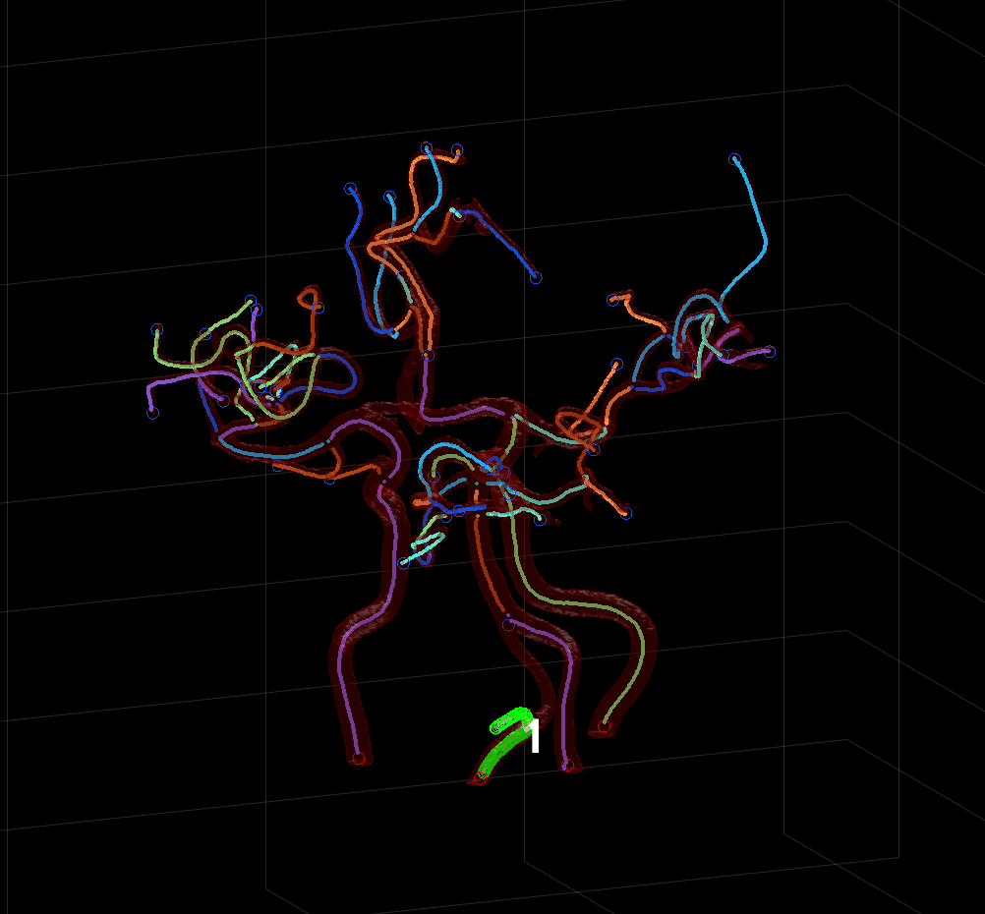
Visualizer
Visualizer update v2.3.3
현재 접근중인 branch만 초록색으로 표시
좌우키: branch 이동
위아래키(New): branch number 크기 조정
Hwan-ho Cho, Dept of Medical Artificial Intelligence, Konyang Univ.

Slide 8
Unsolved
2022.07.04
Hwan-ho Cho, Dept of Medical Artificial Intelligence, Konyang Univ.

Slide 9
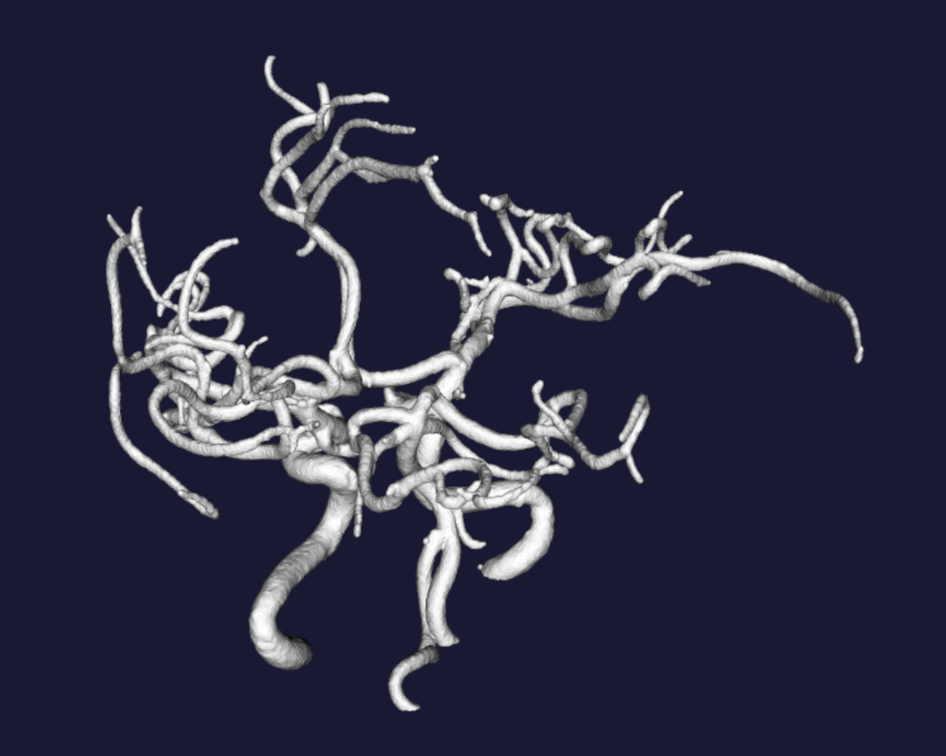
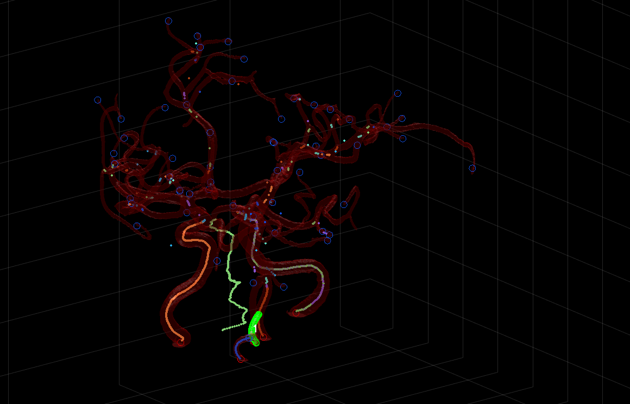
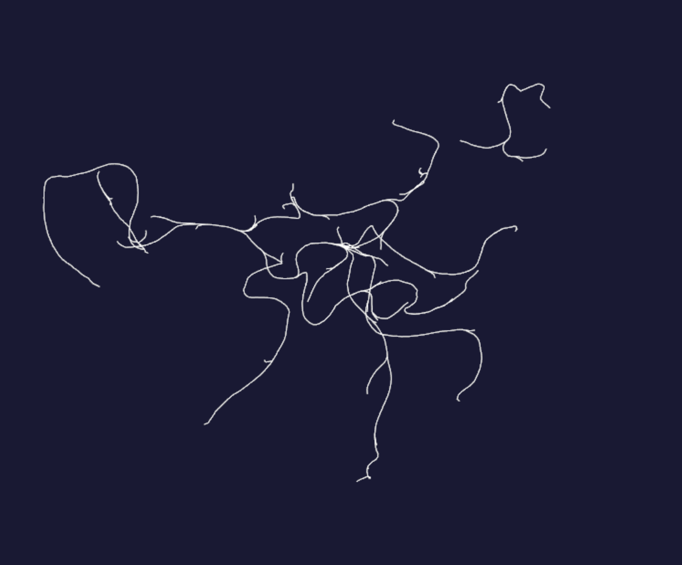
TOF0761
계산은 되지만 추가로 문제점 파악 후 대응해야할 듯
최종결과물
중간결과물
Hwan-ho Cho, Dept of Medical Artificial Intelligence, Konyang Univ.

Slide 10
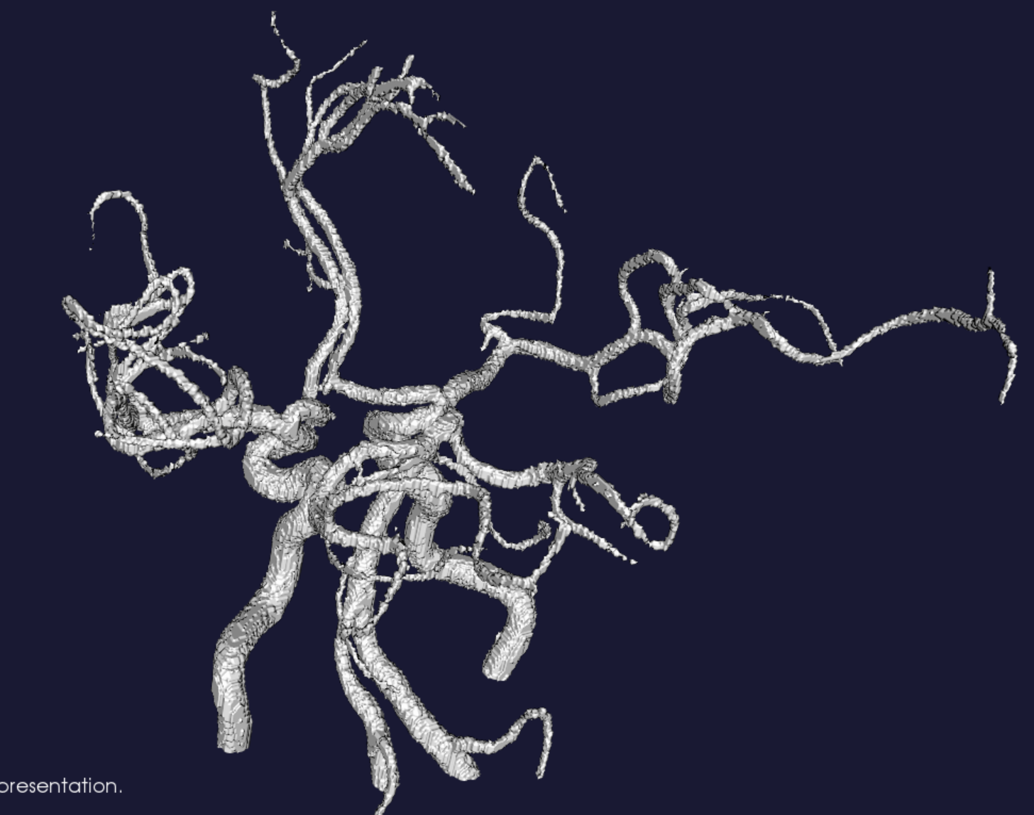
TOF0833, 0.2841mm
Segmentation quality check
Hwan-ho Cho, Dept of Medical Artificial Intelligence, Konyang Univ.

